Slide 1
19CSE211 Computer Architecture & Organization
Multi Cycle Data Path Implementation of MIPS Architecture-Part 3

Slide 2
1.Instruction Fetch Step

Slide 3
2. Instruction decode and Register fetch step

Slide 4
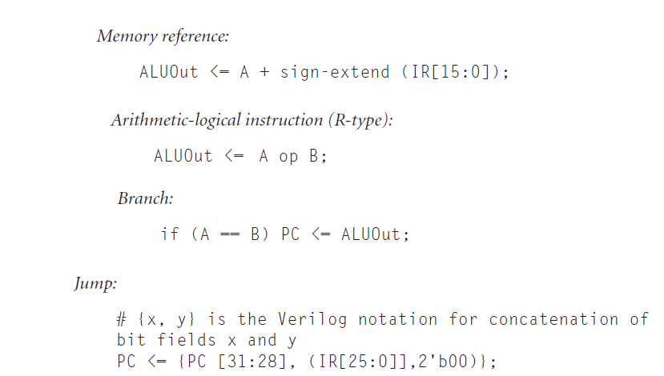

Slide 5
